Slide 1
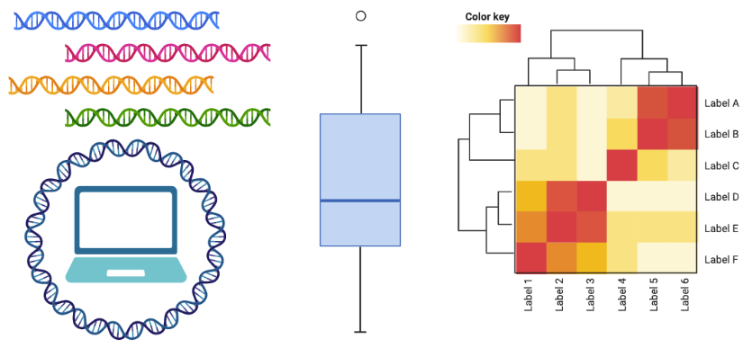
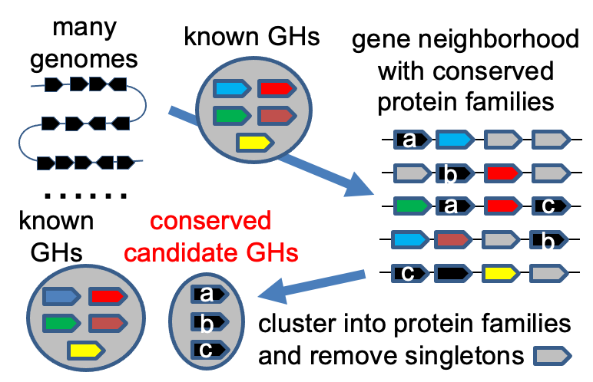
Computational Biology Summer Workshop
Choose a day and RSVP: https://www.when2meet.com/?15855740-coiPZ
Free to anyone with life/agricultural science background
Organized by Dr. Yanbin Yin, Associate Prof of Nebraska Food for Health Center & Food Science & Tech Dept
Taught by experienced bioinformatics postdocs and students of NFHC
Practical Bash, Python and R skills to analyze sequencing data and produce publishable graphs
Hands-on project of (meta)genome mining for carbohydrate active enzymes as a case study
Date: A half day (4h) of the 3rd week (20-23) of June will be chosen according to a time survey (see the top)
Location: In person at Food Innovation Center 220

Slide 2
Schedule (June 20 and 23, FIC 111)
Time | Presenter | Topic
12:00-12:30pm | Yanbin | Introduction to the workshop & project
12:30-1:00pm | Tang | UHGG Bacteroides MAGs & stat visualization
1:00-1:45pm | Yuchen | CAZyme & CGC annotation & stat visualization
1:45-2:30pm | Yuchen | Anvio pan-genome analysis & phylogeny visualization
2:30-2:45pm |  | Break
2:45-3:30pm | Bowen | Pfam annotation & protein seq clustering of nSGs & visualization
3:30-4:15pm | Tang | Glycan substrate prediction & CGC clustering & network visualization
4:15-5:00pm | Jinfang | ML prediction for new GH/PL from conserved nSGs
GitHub page:
https://github.com/tli14/Workshop_2022_YinLab

Slide 3
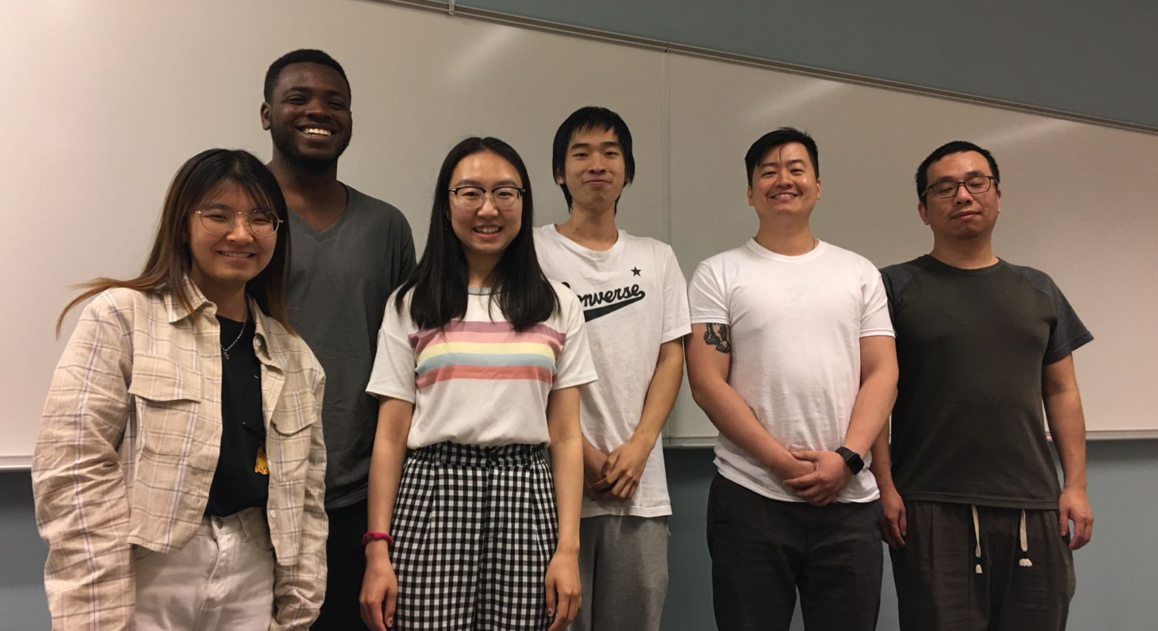

acknowledgements
Jerry
Arthur
Ved
Yuchen
Tang
Bowen
Jinfang

Slide 4
what you need to know
use holland computing cluster so bring a laptop and have an HCC account
hands-on activities with a real-world genome mining project
focus on data visualization during workshop demonstration
some data computing takes long time, but all intermediate files and codes are provided
use HCC OnDemand -> R studio + Shell terminal

Slide 5

lower your expectations
don’t expect you will understand/learn everything we say
it is okay if you can’t follow every step (all the codes and files are provided)
the instructors won’t have time to explain all the codes (it’s a win as long as you can get the right graphs/files)
questions are welcomed, but we will try to stay on time

Slide 6
about the project
a new project from a recent proposal
it will or should work
input -> genomes,
output -> new GH predictions
our focus is data analysis and visualization

Slide 7
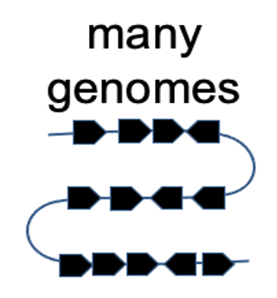
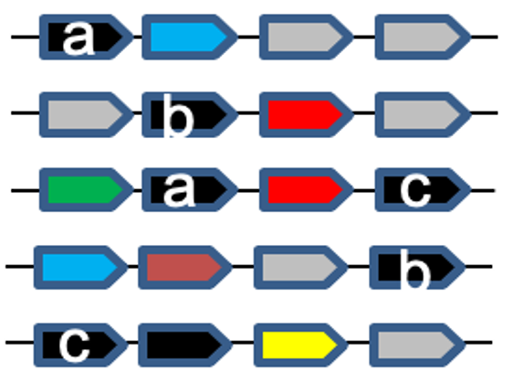
steps
input -> 45 Bacteroides genomes from human gut
find CAZymes and CGCs (CAZyme gene clusters)
find null or non-signature genes in CGCs
cluster nSGs into families
predict the likelihood of conserved nSG families to be new CAZymes

Slide 8
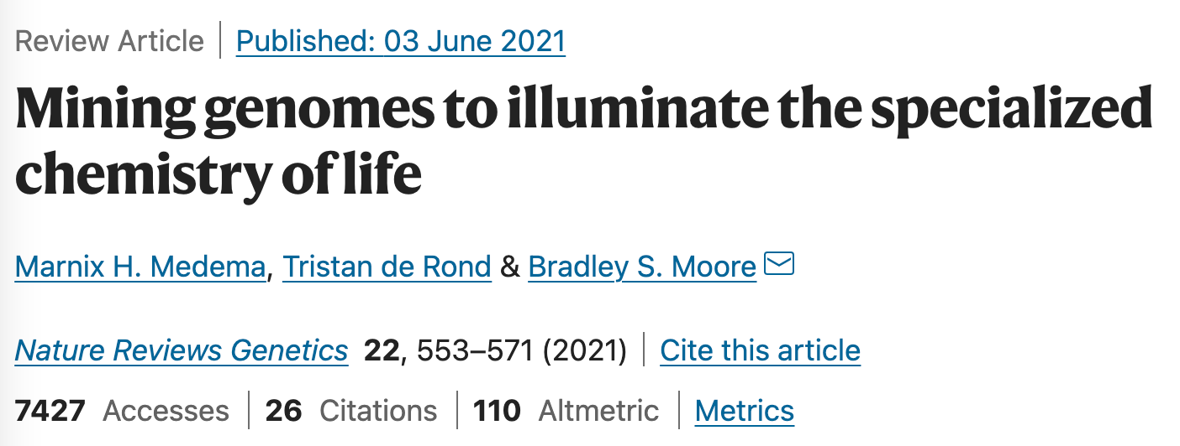
(meta)genome mining
Targeted search of genomes for specific pathways or genes with important economic values using advanced computational data mining approaches

Slide 9
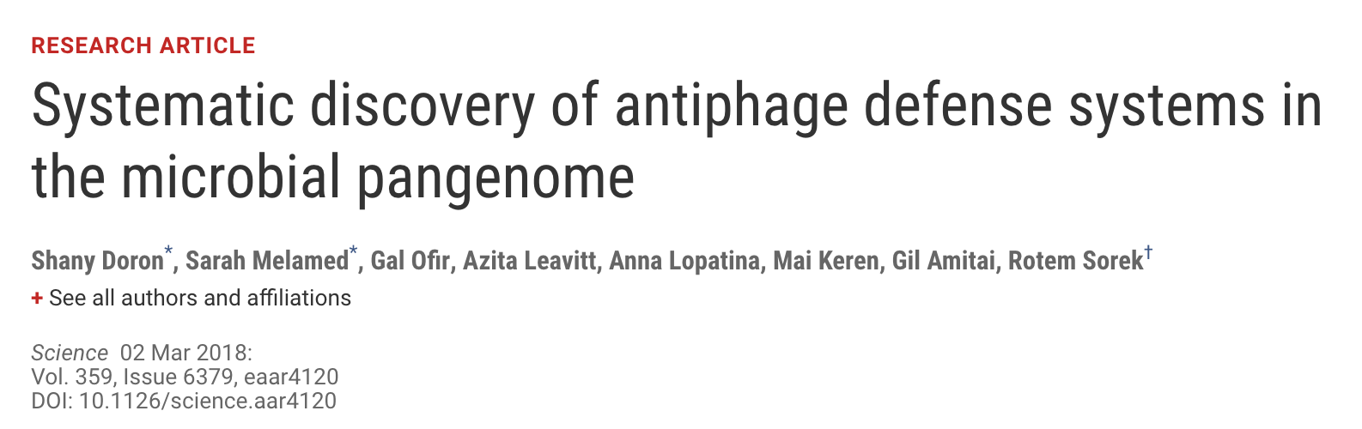
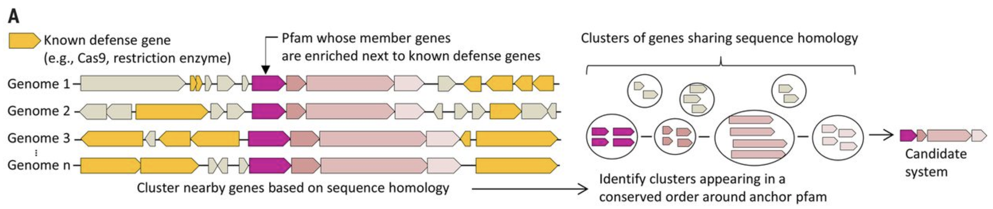
Defense island: gene clusters that encode antiphage defense genes

Slide 10
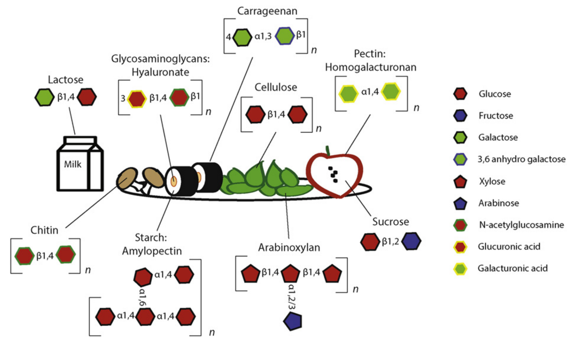
a high diversity of dietary carbohydrates
J Mol Biol (2016) 428, 3230–3252
Notes:
if you think about what your eat everyday, there are a high diversity of dietary carbohydrates in our foods from milk to vegie to fruit and meat. These carbohydrates exist as various polysaccharides, and glycoproteins, containing a high diversity of monosaccharides and of their linkages that connect them into glycan polysacccharides.

Slide 11
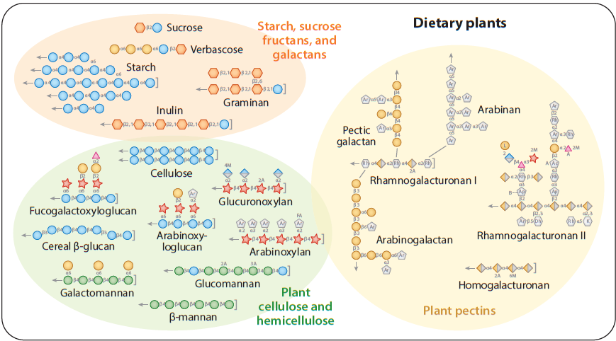

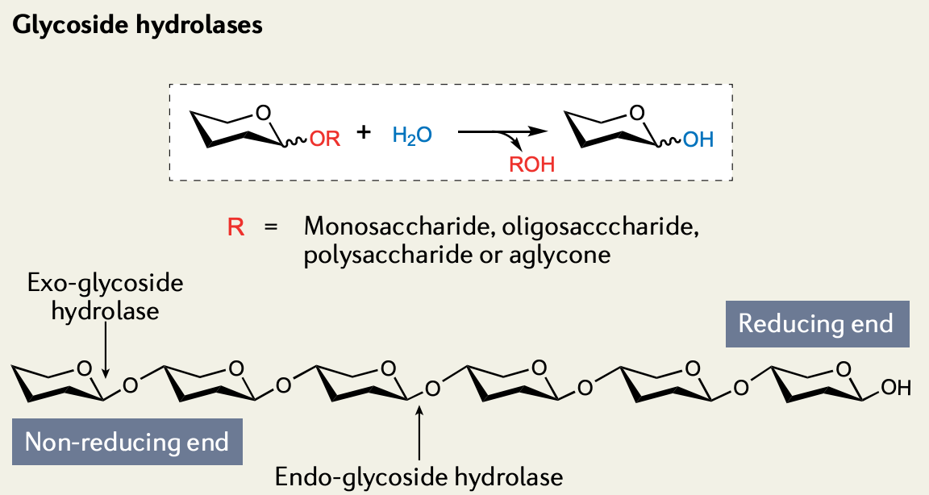
diverse glycosidic linkages exist in the dietary carbs
Annu. Rev. Microbiol (2017) 71:349–69
Notes:
These sugar connecting linkages are called glycosidic bonds. Breaking these bonds need carbohydrate active enzymes or CAZymes. Each of these different glycosidic bond will need a different CAZyme. Therefore to fully break down complex carbs into simple sugars, a large number of CAZymes will be needed.

Slide 12
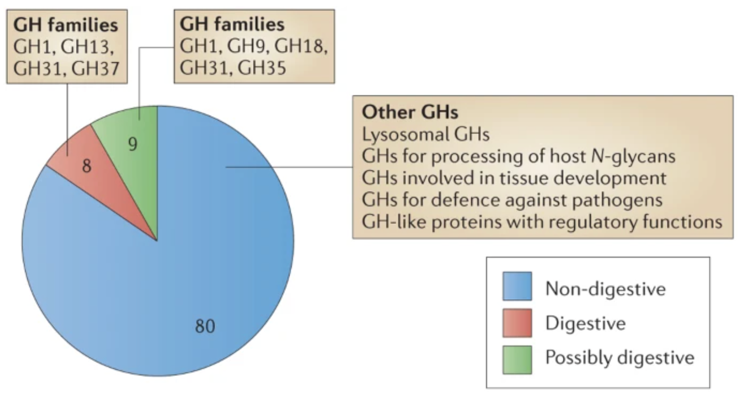
diverse glycosidic linkages need various CAZymes to break
http://www.cazy.org/
Human encodes 17 food digesting GHs
GlycosylTransferases (GTs): 115
Glycoside Hydrolases (GHs): 172
Polysaccharide Lyases (PLs): 42
Carbohydrate Esterases (CEs): 19
Auxiliary Activities (AAs): 17
Carbohydrate-Binding Modules (CBMs): 89
Cantarel B. et al. 2009, Nucleic Acids Res
Lombard V. et al. 2014, Nucleic Acids Res
NATURE REVIEWS | MICROBIOLOGY, doi:10.1038/nrmicro3050, Kaoutari, 2013
Notes:
The CAZy database collects all the experimentally characterized CAZymes. They regularly curate biochemical data and collect their protein homologs to form six classes with each class including between over a dozen and almost 200 families. If looking at the human genome, there are only 17 food digesting GH CAZymes. So most of dietary fibers can’t be digested by human enzymes in upper GI tract and will reach the large intestine for gut microbes to digest

Slide 13
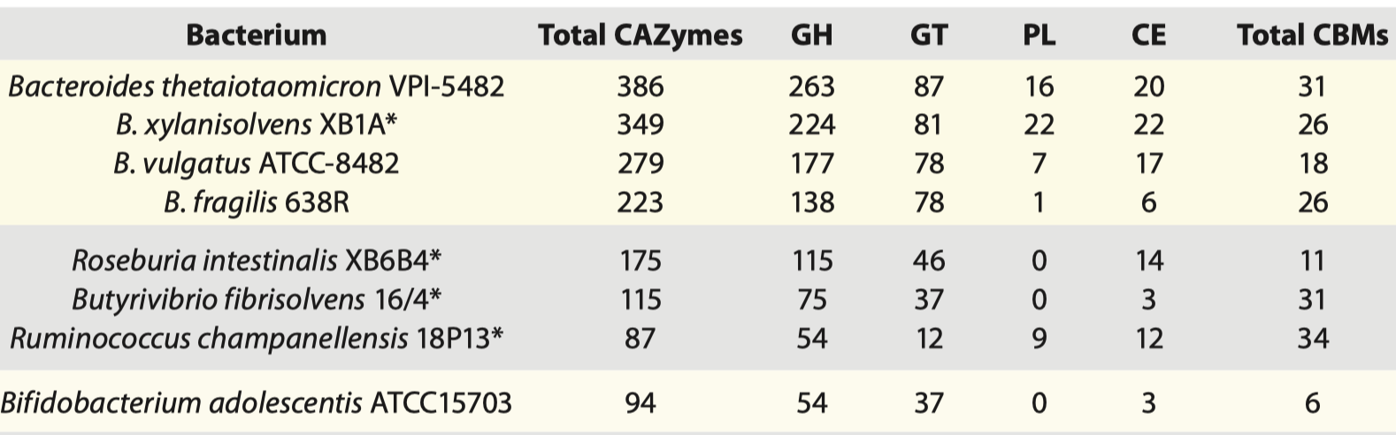
gut bacteria dedicate > 6% of their genes to CAZymes
Gut Microbes 3:4, 289-306; 2012
1000 (species) x 100 (genes) = 100,000 CAZymes
Notes:
That is why gut bacteria typically encode more than hundreds of CAZymes. Some bacteria can have over 6% of its genes encoding CAZymes. If there are 1000 bacterial species in human gut and each has 100 CAZyme genes, this means 100,000 CAZymes genes present in human gut microbiome, much larger than the number in human genome.

Slide 14


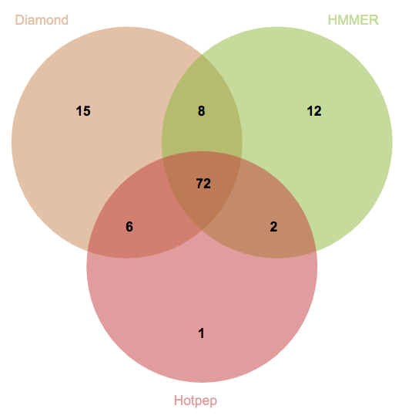
dbCAN2 combines three tools for CAZyme genome mining
BLAST vs. CAZy (before 2012)
Tanner
Family X
New genome
CAZymes
HMMER vs. dbCAN (after 2012)
Le
Family X
eCAMI (after 2017)
Family X
dbCAN: Yin et al, Nucleic acids research 2012
eCAMI: Xu J et al., Bioinformatics, 2020
Notes:
How do people annotate their microbial genomes and metagenomes for CAZymes? Before 2012, people BLAST their query against the CAZy protein sequence database. However, CAZymes are known to be modular and contain multiple domains. In 2012, we build a CAZyme HMM database called dbCAN, which defines a signature domain for each CAZyme family. This allows to identify all the CAZyme modules in a given query. After 2017, there are tools developed for short discrete amino acid peptides as the signature of each CAZyme family. One of these tools eCAMI was published by our lab in 2020. In 2018, we combined the three ideas and developed a meta server called dbCAN2, and we found CAZymes annotated by 2 and 3 tools are more accurate predictions.

Slide 15
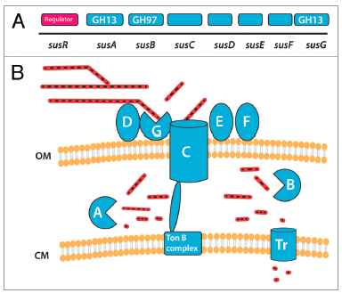
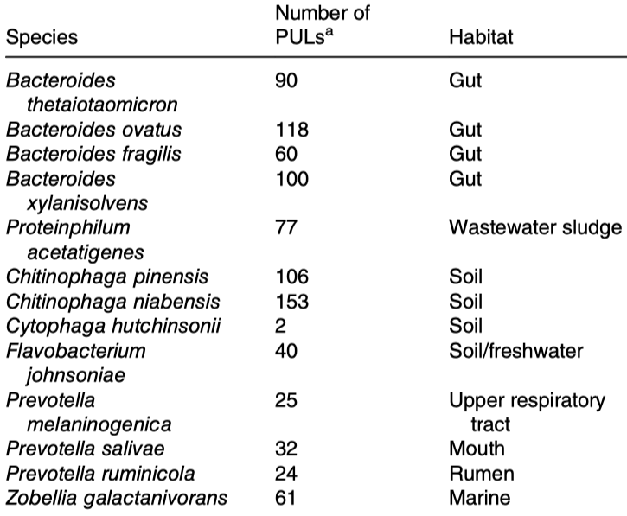
PUL: polysaccharide utilization loci
Sus in Bacteroides thetaiotaomicron
Gut Microbes 3:4, 289-306; 2012
Environmental Microbiology Reports (2021)
Notes:
One of major findings in carbohydrate utilization research is the discovery of polysaccharide utilization loci in late 1990’s. The first studied PUL is the starch utilization loci in Bacteroides theta, which contains three CAZymes, two transporters, one regulator, and others likely sugar binding proteins. Since 2005, hundreds of PULs have been described in the literature, while most of them are characterized in gram- bacteria. In 2016, PULs were also found in gram+ bacteria.

Slide 16
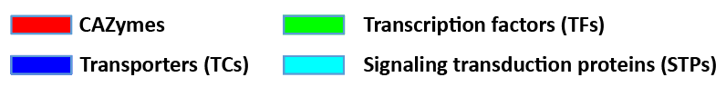
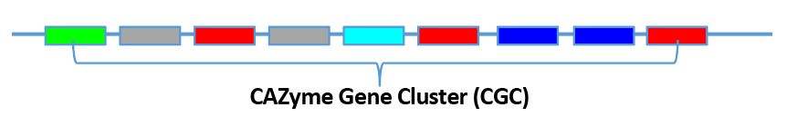
CGC-Finder: predict CAZyme gene clusters from (meta)genomes
Huang et al., Nucleic Acids Res 2018
Le
predict genes
predict signature genes
call CAZyme gene clusters
The distance threshold:
how many non-signature genes are inserted between two adjacent signature genes
Notes:
Obviously, CAZymes forming gene clusters is wide spread phenominon that microbes have evolved to adapt to carbohydrate rich environments like animal gut, forest floors, soils, oceans. Determining the substrates oof these gene clusters requires experimental characterization and can't be done in a high-throughput manner. However, predicting these gene clusters can be automated computationally. We have developed CGC-finder, a program to automatically scan any given DNA sequences to identify co-localized CAZymes, TCs, TFs, and STPs. It is integrated in the dbCAN tool package. Here is an example CGC that we identified from a RefSeq bacterial genome. It contains 42 genes and 35 are CAZymes.

Slide 17





Summary
a very high diversity of carbs in our diet (other environment too)
dbCAN -> automated CAZyme genome mining
dbCAN-PUL -> literature derived PULs with known carb substrates
complex carb degrading genes form gene clusters in genomes
CGC-Finder can mine for these CGCs (without substrates)
https://bcb.unl.edu/dbCAN2
https://github.com/linnabrown/run_dbcan
https://bcb.unl.edu/dbCAN_PUL
https://github.com/yinlabniu/eCAMI
https://bcb.unl.edu/dbCAN_seq/
https://bcb.unl.edu/plantcazyme/
https://github.com/linnabrown/run_dbcan
https://bcb.unl.edu/dbCAN_PUL
https://github.com/yinlabniu/eCAMI
https://bcb.unl.edu/dbCAN_seq/
https://bcb.unl.edu/plantcazyme/
https://bcb.unl.edu/pHMM-Tree/source/
Notes:
Here is a list of web links to our dbCAN families tools.

Slide 18

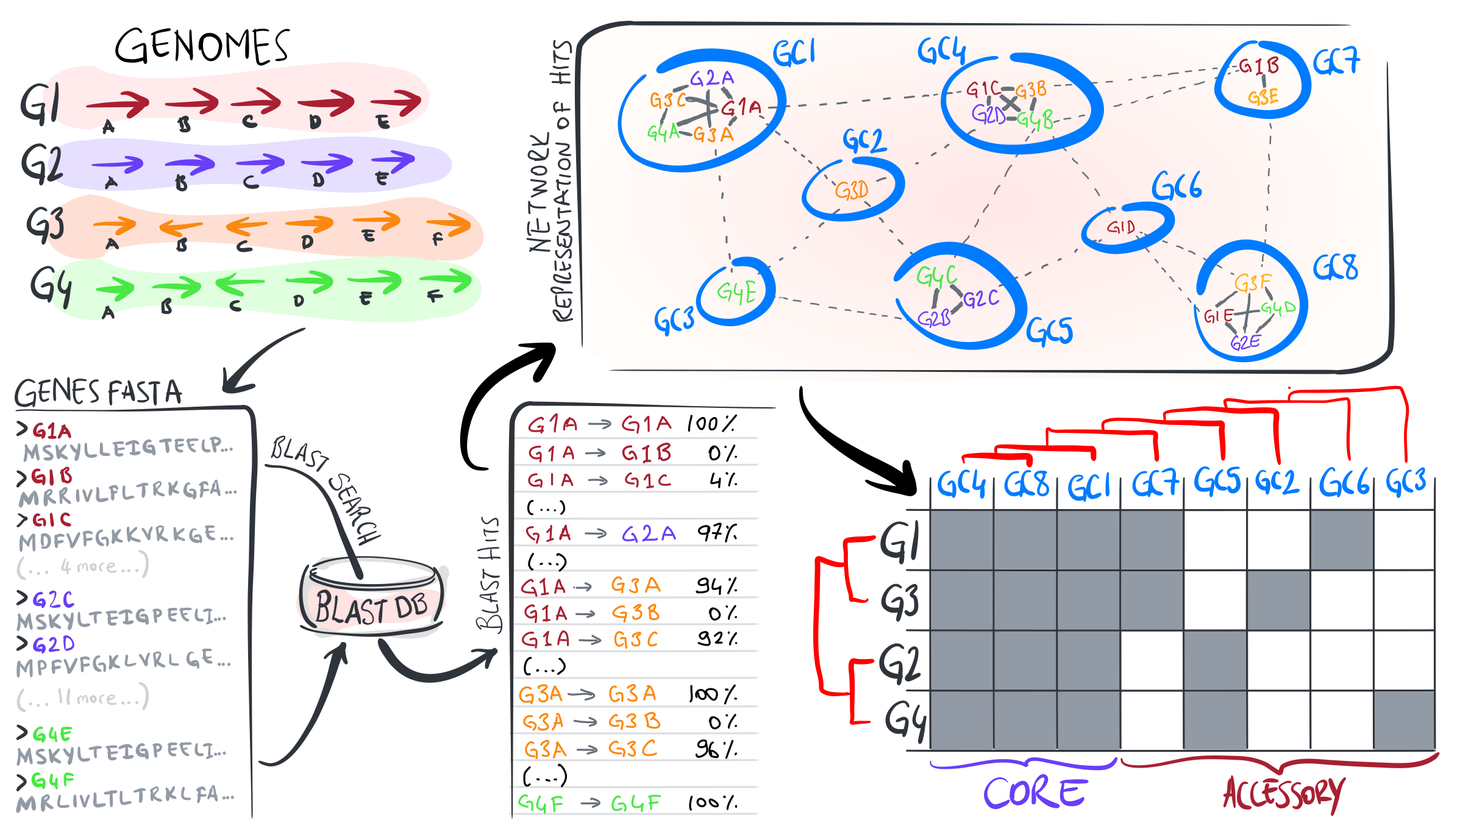
pan-genomics

Slide 19
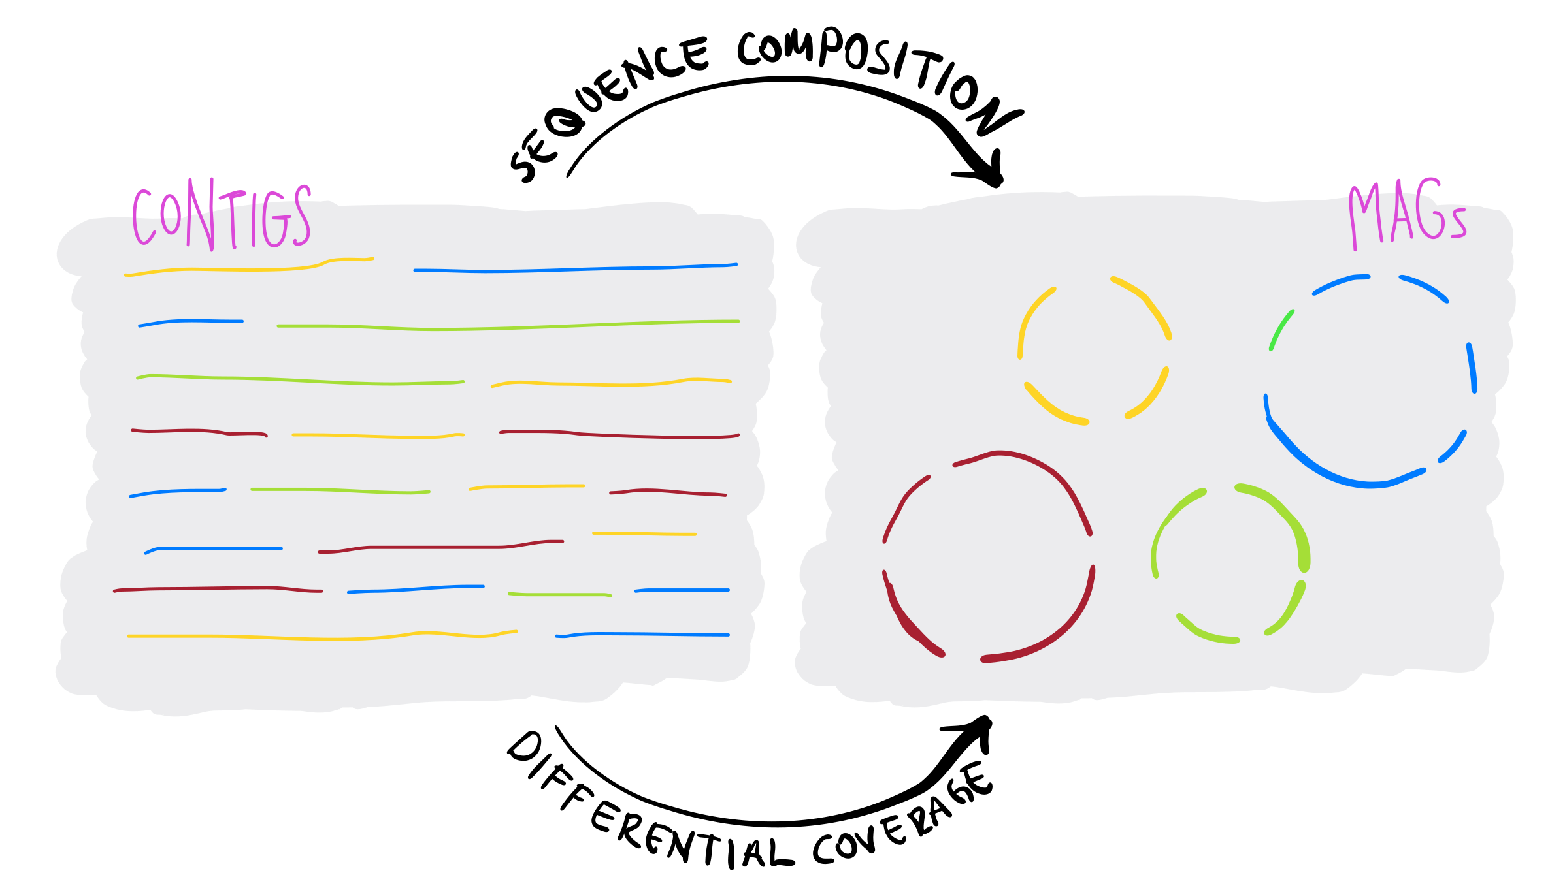
MAGs

Slide 20
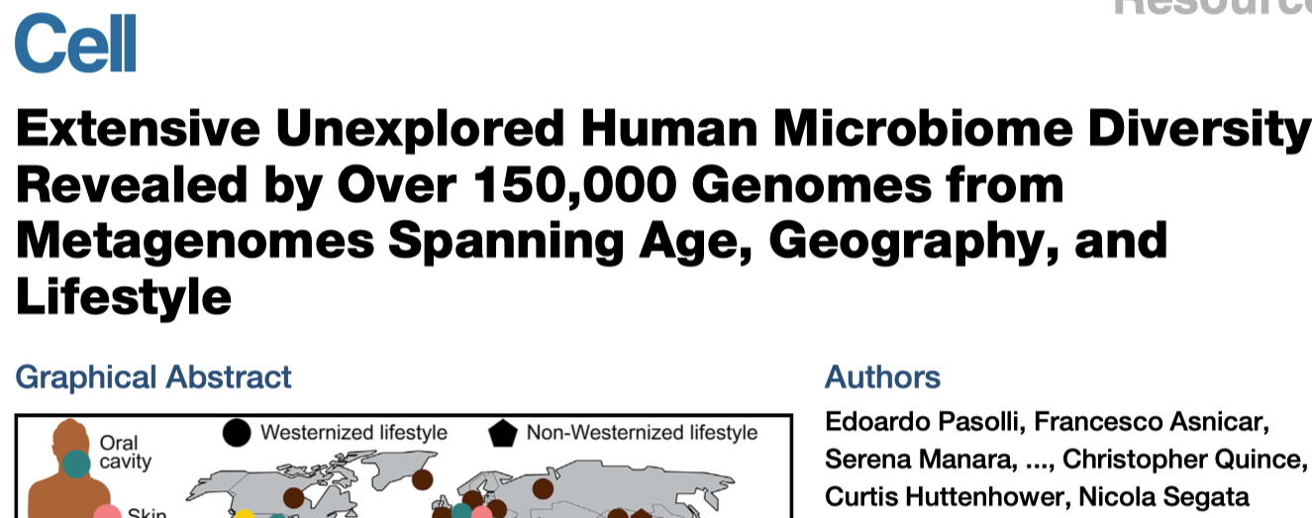
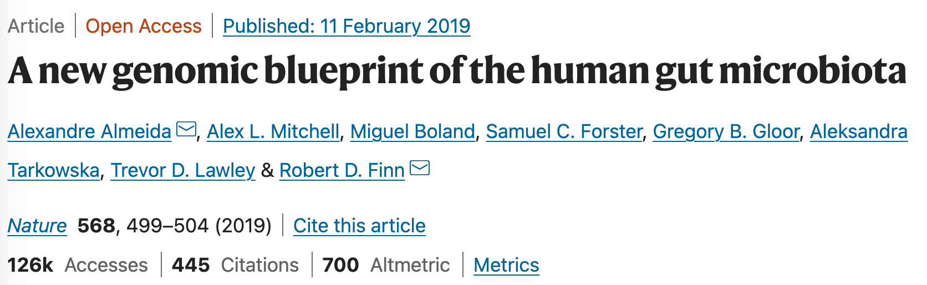
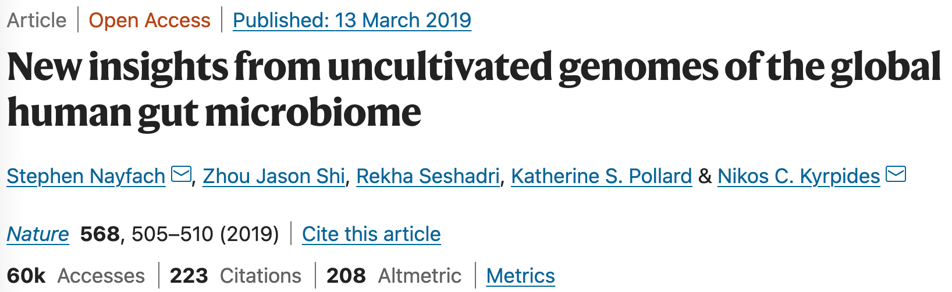
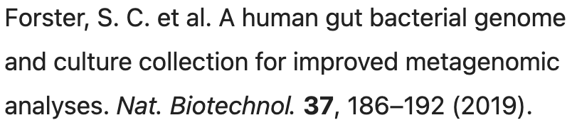
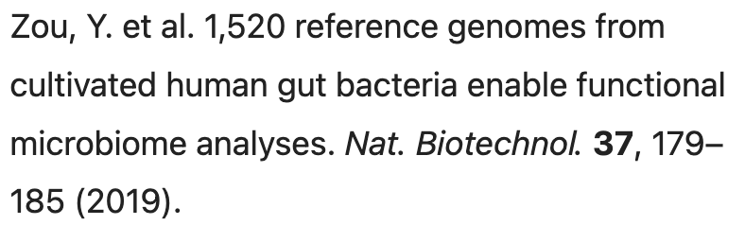
CIBIO
Human microbiome
EBI
HBC, CGR
JGI

Slide 21
Schedule (June 20 and 23, FIC 111)
Time | Presenter | Topic
12:00-12:30pm | Yanbin | Introduction to the workshop & project
12:30-1:00pm | Tang | UHGG Bacteroides MAGs & stat visualization
1:00-1:45pm | Yuchen | CAZyme & CGC annotation & stat visualization
1:45-2:30pm | Yuchen | Anvio pan-genome analysis & phylogeny visualization
2:30-2:45pm |  | Break
2:45-3:30pm | Bowen | Pfam annotation & protein seq clustering of nSGs & visualization
3:30-4:15pm | Tang | Glycan substrate prediction & CGC clustering & network visualization
4:15-5:00pm | Jinfang | ML prediction for new GH/PL from conserved nSGs

Slide 22
How to Use Crane OnDemand for the Workshop ?

Slide 23


Crane OnDemand
Click or copy the link to your browser: https://crane-ood.unl.edu/pun/sys/dashboard
Login using your HCC account.
Click “Clusters” at the top bar.
Select and click the “_Crane Shell Access”

Slide 24
Copy folder and open tutorial HTML
Step 1: Change directory from HOME to WORK: cd $WORK
Step 2: Copy all materials to your working directory:
cp -r /work/yinlab/tangli/workshop_2022 . &
cp -r /work/yinlab/tangli/workshop_2022_backup . &
If failed, try:
cp -r /tmp/workshop_2022 . &
cp /tmp/workshop_2022_backup.tar.gz . &
tar -xvf workshop_2022_backup.tar.gz &
Click his

Slide 25

Copy folder and open tutorial HTML
Step 3: Click or copy this link to your browser to open GitHub page: https://github.com/tli14/Workshop_2022_YinLab.
Step 4: Open tutorial HTML file in GitHub page.
Click this

Slide 26
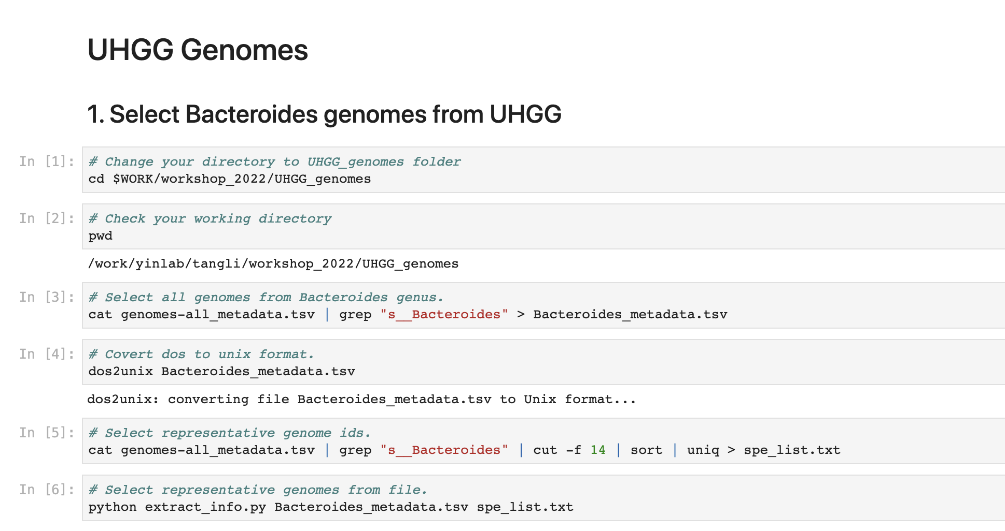
Step 5: Follow the tutorial HTML. Copy and paste each cmd to your “Crane shell” and run it.

Slide 27
Part 1
UHGG Genomes

Slide 28
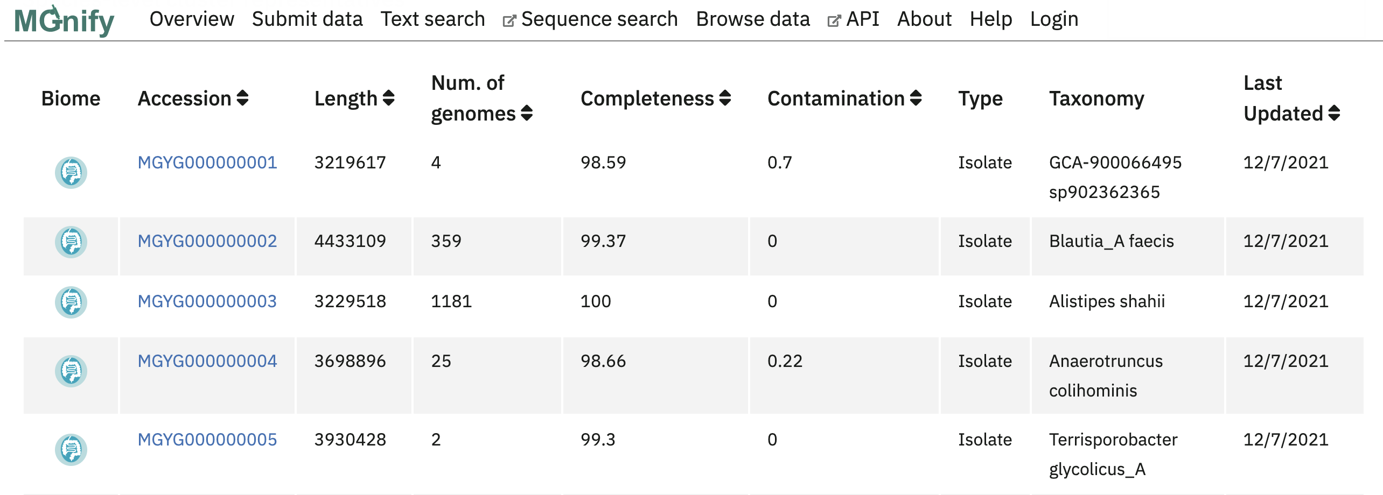
Unified Human Gastrointestinal Genome (UHGG)
A total of 289,232 prokaryotic genomes from the human gut microbiome were clustered into 4,744 species representatives.

Slide 29
Unified Human Gastrointestinal Genome (UHGG)
The “genomes-all_metadata.tsv” was downloaded from this web link: http://ftp.ebi.ac.uk/pub/databases/metagenomics/mgnify_genomes/human-gut/v2.0
Bacteroides: one of the most important genus in human gut microbiome; CAZyme and PULs are well-studied for this genus.

Slide 30
45 Bacteroides genomes from UHGG
Select representative species genomes in Bacteroides genus (n=45).
Download genomes.
Collect metadata information: genome id, species name, genome types, genome length, protein count, contig N50, completeness, country and continent.
Visualize metadata information for 45 genomes.

Slide 31
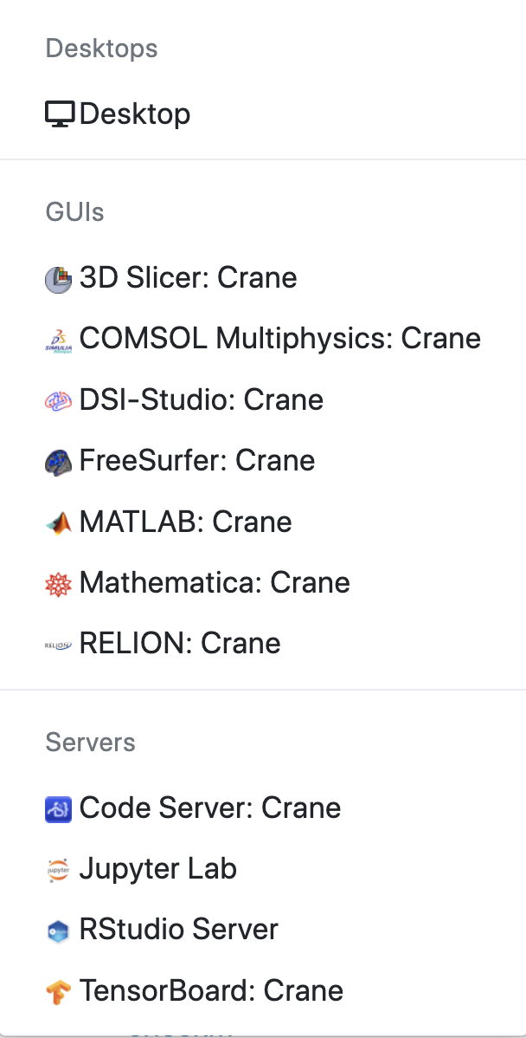
Use Crane OnDemand Rstudio server:
1
Click “Interactive Apps” at the top bar.
Click “Rstudio Server” to start the Rstudio.
2

Slide 32
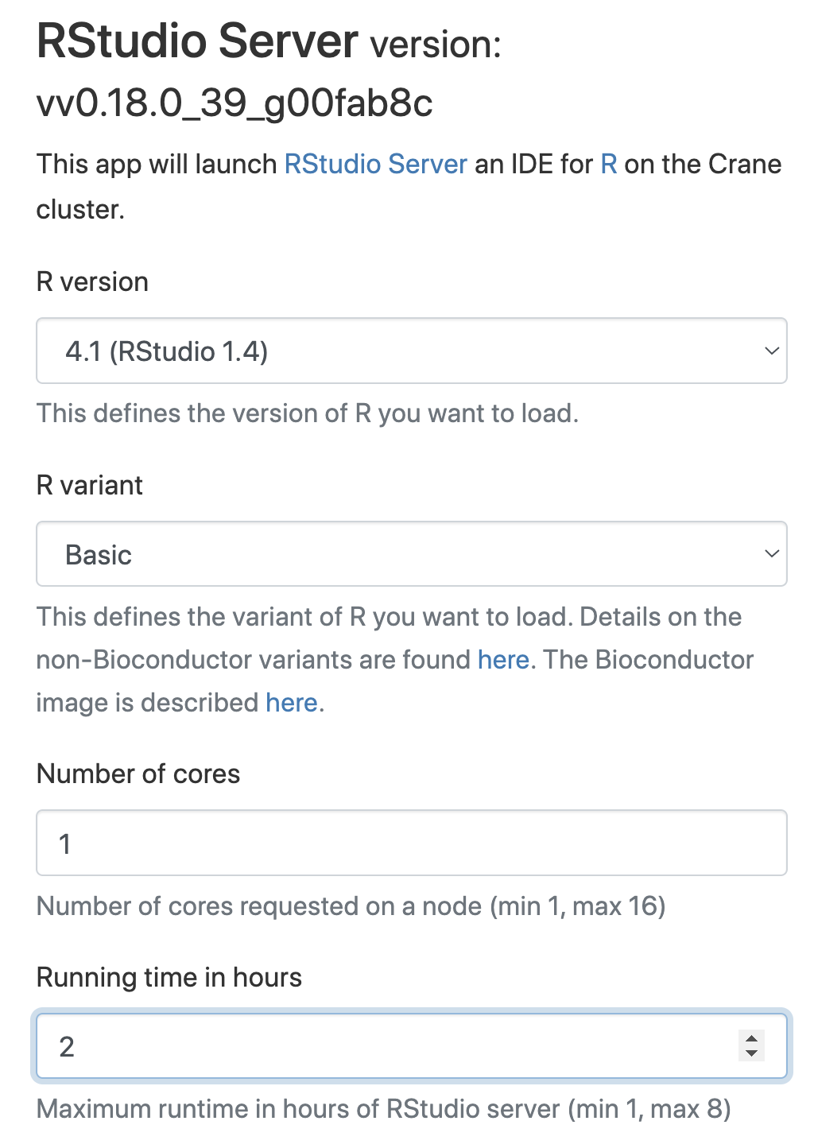

Use Crane OnDemand Rstudio server:
3. Set running time to 1 or 2 hrs.
4. Click “Launch” at the bottom of the page.
4
3

Slide 33
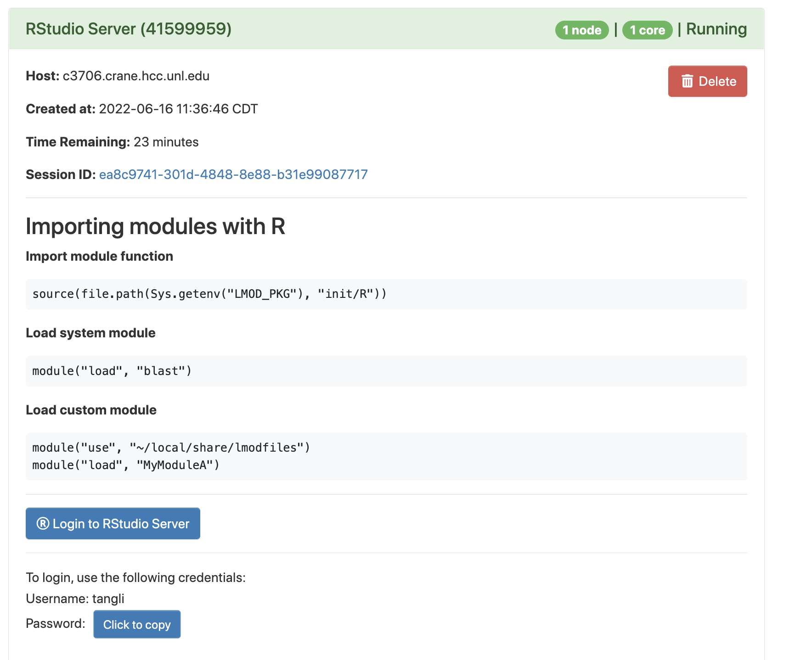
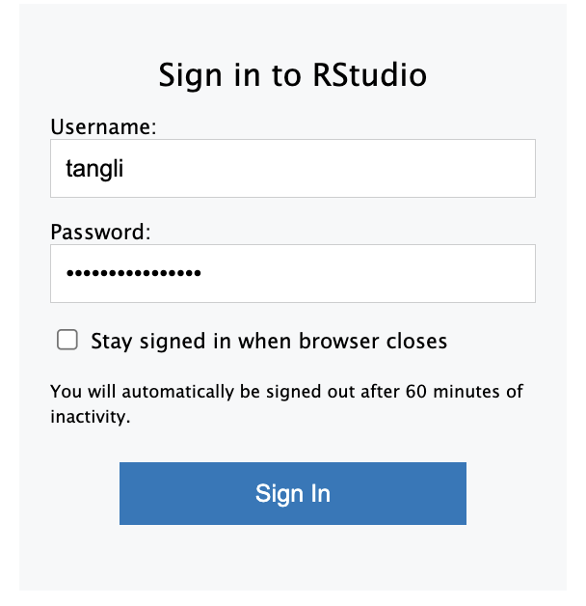
7
7. Login using username and copied password.
6
6. Click to login.
5
5. Click to copy the password.

Slide 34
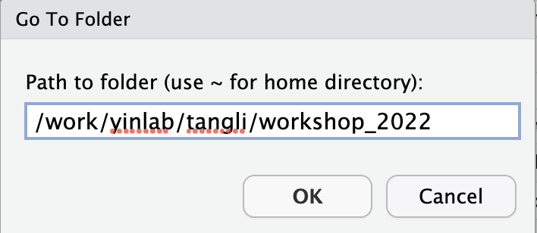
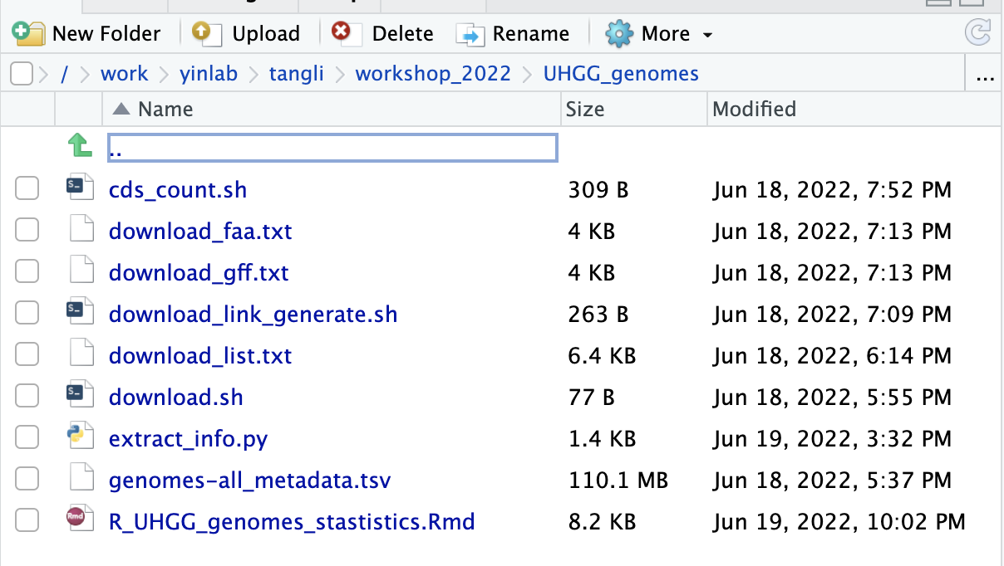
8.Click “…”to change the directory
8
9. Enter your working directory path: /work/your_group/your_name/workshop_2022
9
10. Open “UHGG_genomes
/ R_UHGG_genomes_stastistics.Rmd”
10

Slide 35
The Overall Statistics of 45 genomes
Genomes: 17 MAGs (red) and 28 isolates (back).
Average Length: ~4.87 Mb.
Completeness: 99.46% - 62.07% (only 5 genomes < 90%)
Protein count: 6,436 - 1,444.

Slide 36
The Overall Statistics of 45 genomes
More isolate genomes than MAGs.
Most are from China, United States and United Kingdom.
Mainly from Asia.

Slide 37
Group comparison for 45 genomes.
Isolate genomes have larger average genome size and more proteins than MAGs.

Slide 38
Part 2
CAZyme and CGC analyses

Slide 39
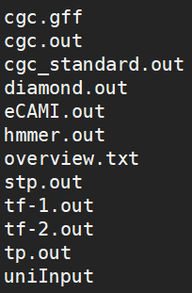
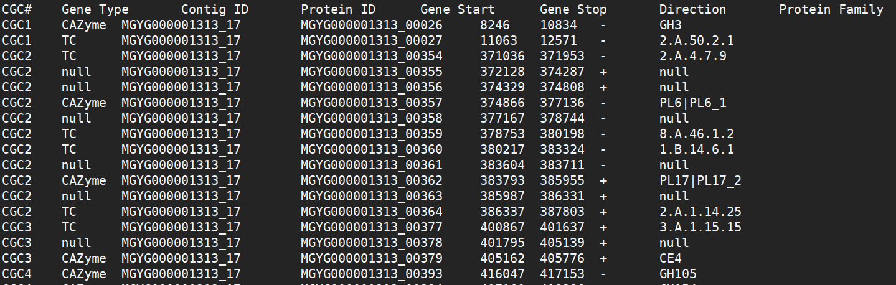
Run dbCAN3 for CAZyme and CGC annotation
Github: https://github.com/linnabrown/run_dbcan
Online server: https://bcb.unl.edu/dbCAN2/
Install and run on terminal or submit sequence to online server
dbCAN3 output files
cgc_standard.out

Slide 40
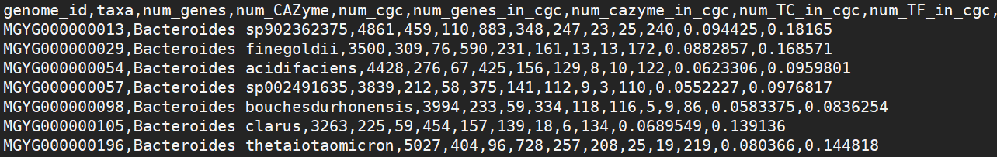
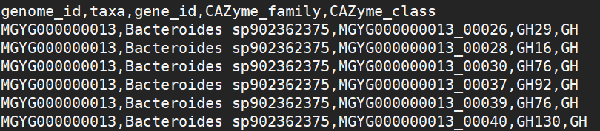
CAZyme and CGC analyses
Count the number of CAZymes and CGCs in each genome
(taxa_number_count_and_percentage.csv)
CAZyme family analyses
(taxa_cazyme_family.csv)
Visualization by R, go to RStudio!
R Markdown file for making plots:
count_across_cgc.Rmd
CAZyme_family_distribution.Rmd

Slide 41
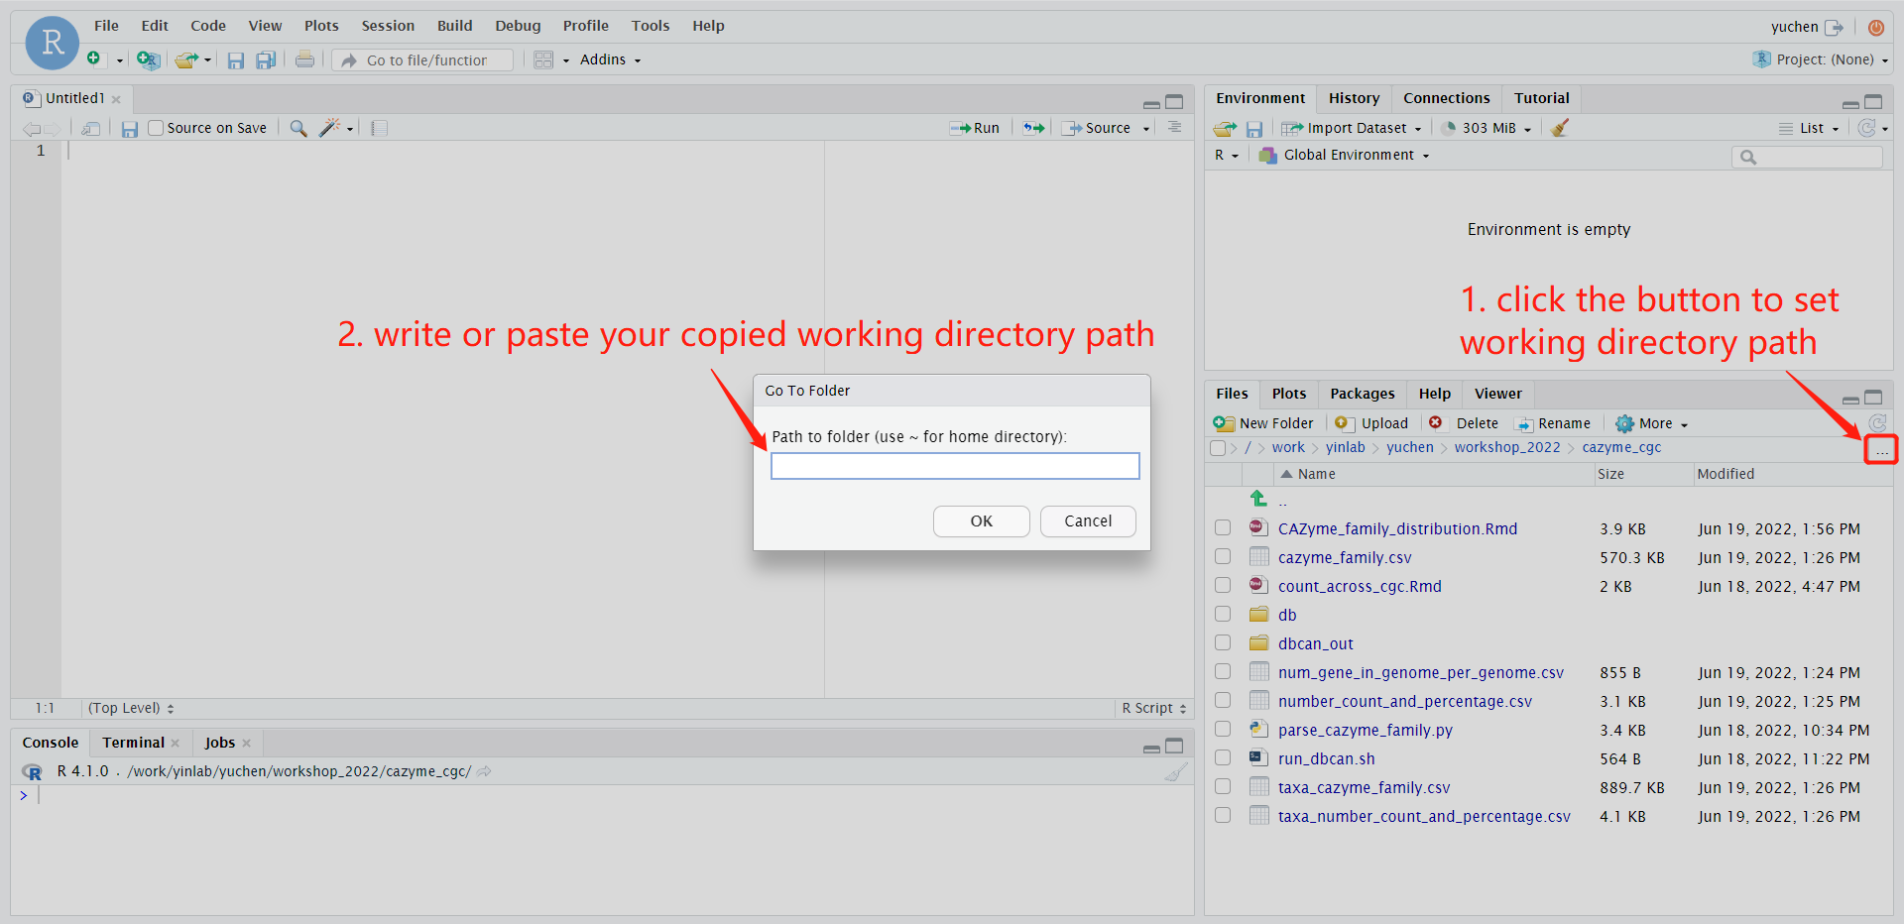
Visualization in RStudio
R Markdown file for making plots:
count_across_cgc.Rmd
CAZyme_family_distribution.Rmd
Set working directory to cazyme_cgc/

Slide 42
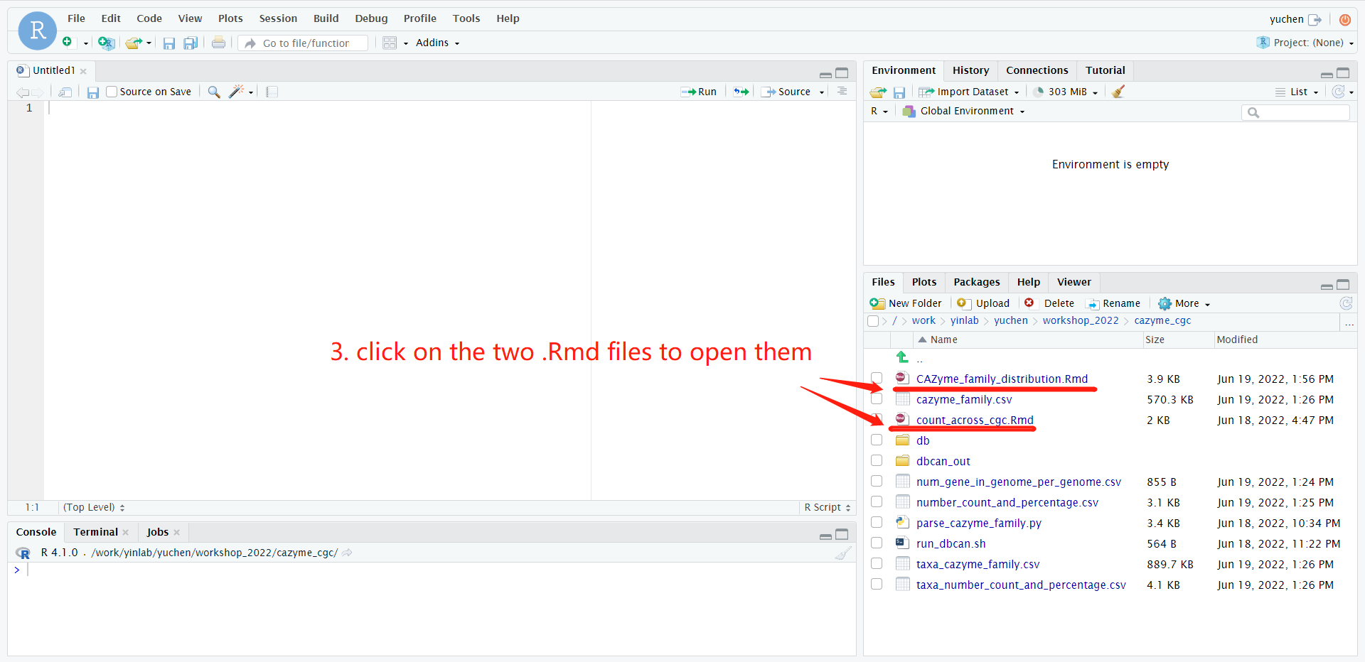
Visualization in RStudio
R Markdown file for making plots:
count_across_cgc.Rmd
CAZyme_family_distribution.Rmd
Set working directory to cazyme_cgc/

Slide 43
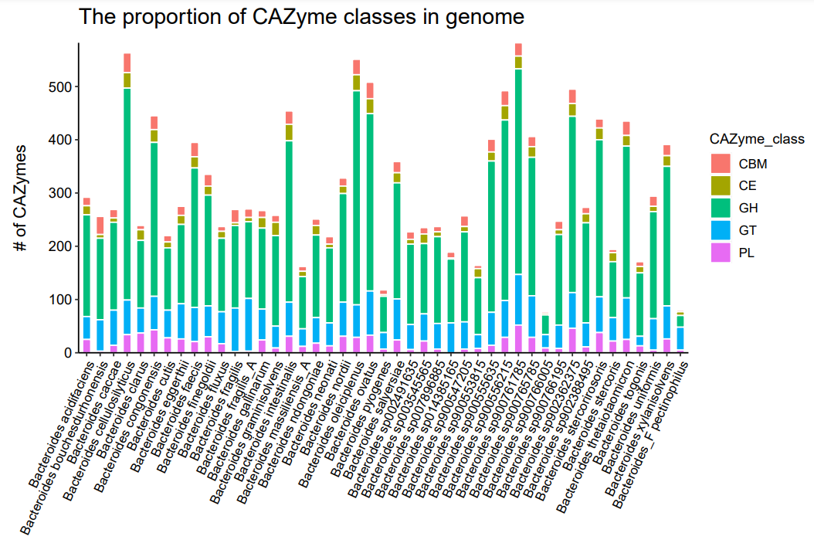
Plots of CAZyme and CGC analyses
The proportion of CAZyme classes in genome (cazy_class_stackbar.pdf)
The total number of CAZymes varies across genomes.
GH account for the largest proportion in most of genomes

Slide 44
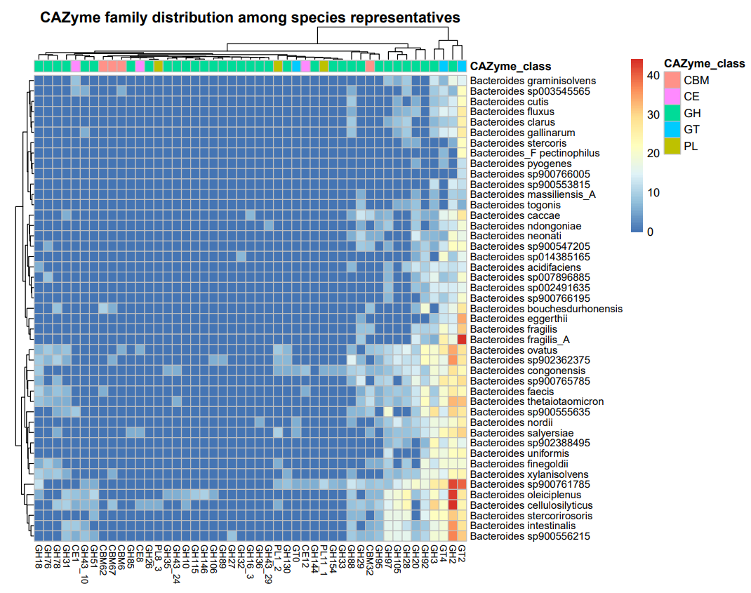
Plots of CAZyme and CGC analyses
CAZyme family distribution among spp representatives (cazy_distr_hm.pdf)
The number of CAZyme families in one genome > 5
Some CAZyme e.g. GT2, GH3 are very common and abundant

Slide 45
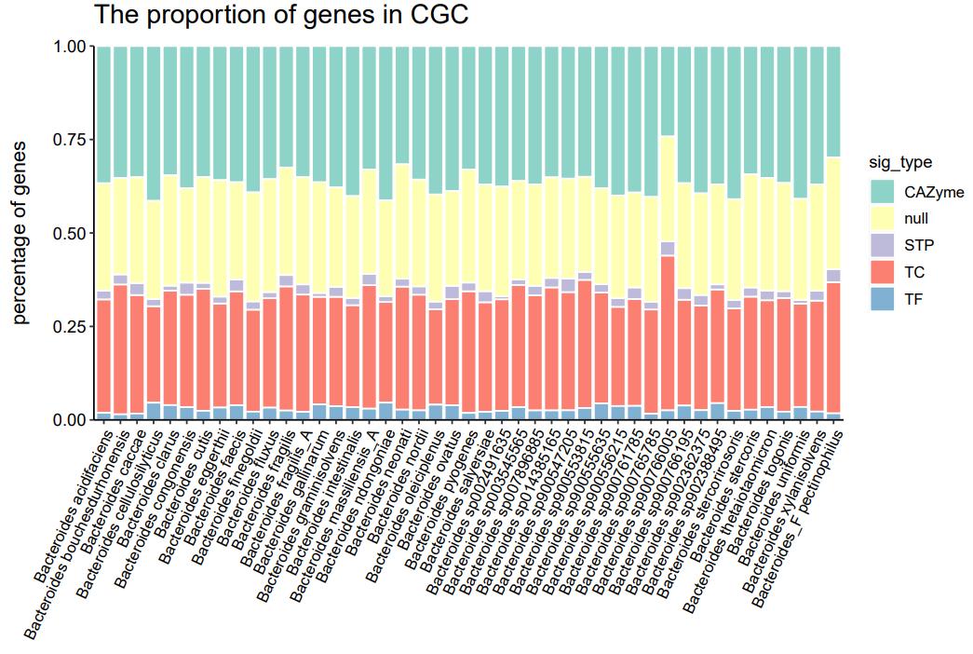
Plots of CAZyme and CGC analyses
The proportion of genes in CGC (prop_sig_cgc_stackbar.pdf)
Null genes account for a relatively large proportion within CGC in each genome

Slide 46
Part 3
Pan-genomics by anvi’o
Phylogeny analysis based on SCG alignment by anvi'o

Slide 47
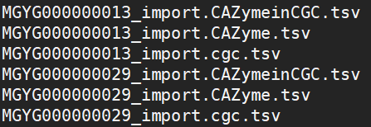
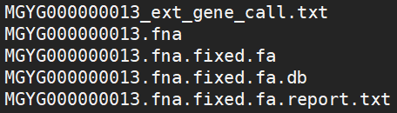
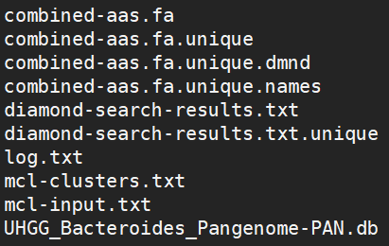
Pangenomics by anvi'o
Make anvio contig database and import dbCAN annotation
function_import_table/
45_Bacteroides_spp_rep_seq/
Make Pan-genome by anvi'o
Pan_OUT/
Visualize anvi'o pan-genome on the interactive page [open local computer terminal]

Slide 48
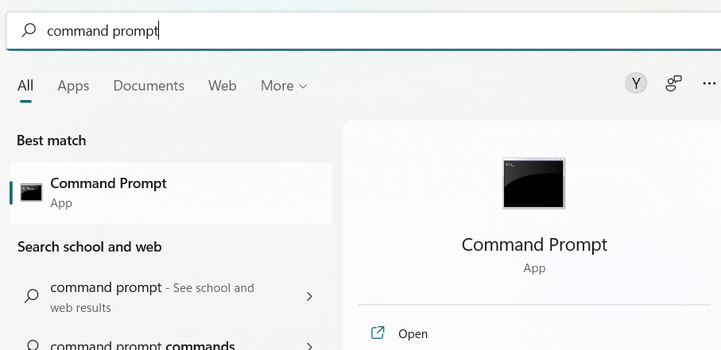
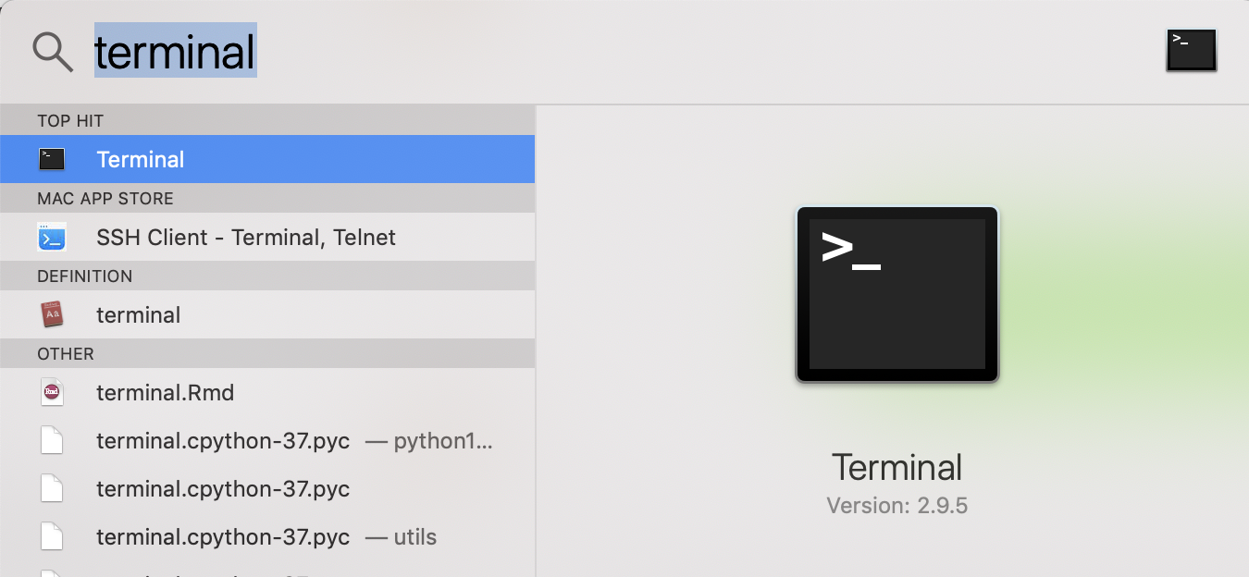
Visualize Anvi’o Pan-genome on the interactive page
Find your local computer terminal and open it
Windows: “Command Prompt”
Mac: “Terminal”
Type in following command lines on your local computer terminal
ssh -L 8080:localhost:8080 yourusername@crane.unl.edu
cd $WORK/workshop_2022/pan_genomics/
ml anvio/7
anvi-display-pan -g storage-GENOMES.db -p Pan_OUT/UHGG_Bacteroides_Pangenome-PAN.db --server-only -P 8080

Slide 49
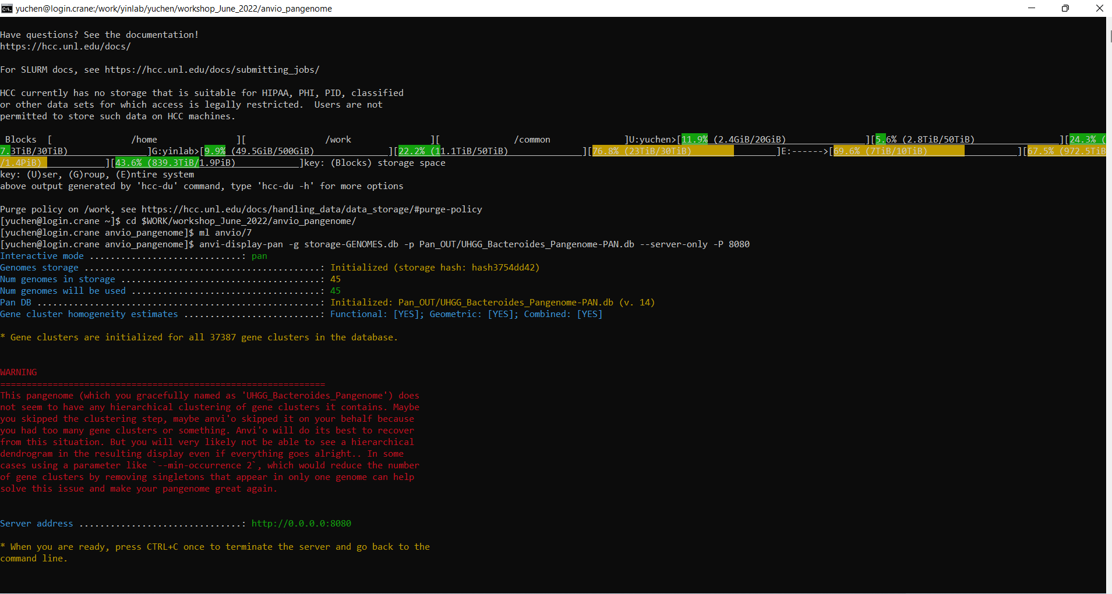
Visualize Anvi’o Pan-genome on the interactive page
If succeed, your terminal should look like the picture.
The server port 8080 may be occupied by others sometimes, just try 8079, 8078, .…..
Then open your web browser, go to the web address: http://localhost:8080

Slide 50
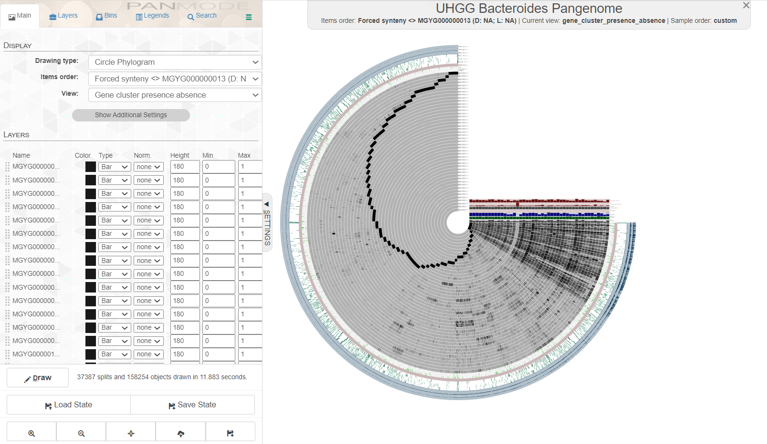
Visualize Anvi’o Pan-genome on the interactive page
http://localhost:8080

Slide 51
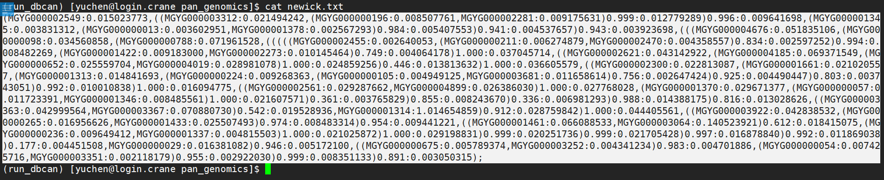
Phylogeny analysis based on SCG alignment by anvi'o
Go back to HCC terminal
We will use anvi’o to generate a newick.txt for phylogenetic tree
Copy the content

Slide 52

Phylogeny analysis based on SCG alignment by anvi'o
Open iTOL web page (https://itol.embl.de/upload.cgi)
Upload newick content for tree visualization

Slide 53

Phylogeny analysis based on SCG alignment by anvi'o

Slide 54

Phylogeny analysis based on SCG alignment by anvi'o

Slide 55

Phylogeny analysis based on SCG alignment by anvi'o
The annotation files are on the github: https://github.com/tli14/Workshop_2022_YinLab
You can also customize your own tree!
The iTOL help page: https://itol.embl.de/help.cgi

Slide 56
Part 4
Pfam annotation of non-signature genes

Slide 57


Pipeline of conserved non-signature genes
Pipeline of substrate prediction

Slide 58

Pipeline of conserved non-signature genes

Slide 59
Script Name: Prepare_null_gene.sh
Script Function: Extract all non-signature gene sequences from dbCAN result.
Input 1: all the fasta sequence (uniInput )
Input 2: cgc predicted by dbCAN (cgc_standard.out )
Output: non-signature gene protein sequences (non-signature.pep )

Slide 60
Script Name: pfam_paralla_job.sh
Script Function: Domain annotation of non-signature genes to get possible function
Input 1: non-signature protein sequences
Input 2: Pfam database.
Output: domain annotation

Slide 61
Script Name: cd-hit.sh
cd-hit -i .pep -o non-signature_40.pep -c 0.4 -M 0 -T 32 -n 2
Input: non-signature protein sequences
Output: clustered non-signature protein at 40% identity
–c 0.4 : global identity = 0.4
–M 0: Memory usage not limited
–T 32: CPU 32
-n 2: word size for global identity
Part1 Function:
Part2 Function:
Annotate the non-signature gene clusters with pfam.

Slide 62
Pipeline of Substrate Prediction

Slide 63
Script Name: Prepare_CGC_seq.sh
Script Function: Extract all CGC sequences from dbCAN result.
Input 1: uniInput all the fasta sequence
Input 2: cgc_standard.out, CGCs predicted by dbCAN
Output: all CGC sequences

Slide 64
Script Name: blastp.sh
Script Function: CGC database search against with PUL database to find homologous
Input 1: CGC sequences
Input 2: dbCAN-PUL database, download from dbCAN-PUL server
Output: homologous hits

Slide 65

Script Name: substrate.sh
Script Function: Deal with blastp result to infer potential substrate
Input 1: blastp outputs (Bacteroides.CGC.PUL.blastp)
Input 2: CGC predictions (cgc_standard.out)
Input 3: dbCAN-PUL.xlsx
Output: CGC with substrate

Slide 66
Pfam annotation for non-signature genes (nSGs)
Two Pfam families (PF07980.14 and PF14322) can be found in 44/45 genomes → only absent in Bacteroides_F pectinophilus.
A total of 25 Pfam families can be found in > 30 genomes.

Slide 67
Pfam unannotated protein clusters for nSGs
The nSGs were clustered into protein clusters.
Some protein clusters without Pfam annotation were found in > 10 genomes, which might be conserved nSGs in Bacteroides genus.

Slide 68

CGC synteny plot with conserved nSG family highlighted
The proportion of genes in CGC (cgc_synteny.pdf)
Null gene DUF4861 without pfam function annotated is conserved in 21 of 45 genomes
CGC containing DUF4861 is also conserved across genomes, with GH43_10 and GH28
Haven’t ordered by phylogeny

Slide 69
Part 5
CGC clustering

Slide 70




CGCs clustering
2. Train and Test Subsets
Prepare Input Table
30% for mapping training
70% for CGC clustering
5. Visualization
4. CGC clustering
3. Convert words to vectors

Slide 71


CGCs clustering results
T-distributed Stochastic Neighbor Embedding (TSNE) plot: visualize high-dimensional data.
The top 10 CGC families and their substrates were found.

Slide 72
CGCs clustering results
Sankey plot: allows to show study flows.
11 CGC families contain at least 25 CGC sequences.
Host glycan is the most abundant substrate for these CGC families.

